Slide 1


Slide 2


G-One
Second Year Project Synopsis
Submitted by
ROLL | NAME
2301420037 | Mohd Rizwan
2301420050 | Kashvi Soni
2301420023 | Aryan Jaiswal
Industry Mentor: Farha
Faculty Mentor: Dr Rupesh
Notes:
New Courses replaced with New Programmes

Slide 3

Project Overview
G-One is an AI-powered health platform designed to empower individuals to better understand and manage their health. Unlike traditional summarizers, G-One focuses on analyzing medical reports, providing users with tailored health assessments, and offering personalized health insights. The platform allows users to upload their medical reports, which are then processed to assess potential health risks.
Key features include:
1.Medical Report Analysis: Upload medical reports for in-depth analysis, including disease identification, symptom prediction, and potential health risks.
2.Medicine Scanner: Scan medication labels for detailed information on provides detailed information about medications, including their purpose, side effects, and possible interactions.
3.Personalized Health Plans: Get exercise and dietary recommendations based on individual health data to enhance overall well-being.
Notes:
New Courses replaced with New Programmes

Slide 4
About the Problem
Problems Identified:
Complex Medical Reports: Difficulty in understanding complex reports leads to confusion about health status.
Lack of Personalization: Existing health apps offer generic advice, not tailored to individual needs.
Medication Safety: Limited access to detailed information on medication usage, side effects, and interactions.
Data Interpretation: Health data is hard to interpret, causing missed trends and risks.
Issues or Problems:
Medical Terminology: Complex language in reports makes it hard for non-medical users to understand.
Unclear Health Insights: Current solutions lack personalized and comprehensive health assessments.
Limited Real-Time Support: Few tools provide instant, actionable insights based on uploaded data.
Data Fragmentation: Health information is scattered across platforms without unified analysis.
Notes:
New Courses replaced with New Programmes

Slide 5
Need of Solution:
Simplified Reports: A tool to analyze and present medical reports in an understandable way.
Personalized Recommendations: Customized advice on symptoms, medications, and lifestyle changes.
Medication Safety: A platform providing full medication details, including interactions and side effects.
Unified Health Data: A single system that aggregates and analyzes health data to offer actionable insights.
Existing Solution:
Generic Health Apps: Offer basic health information but lack in-depth analysis or personalization.
Report Summarizers: Existing tools don’t provide detailed analysis or tailored health insights.
Medication Lookup: Current tools lack comprehensive details like interactions and side effects.
Health Data Platforms: Platforms aggregate data but lack actionable insights or analysis.
Notes:
New Courses replaced with New Programmes

Slide 6
Problem Statement
G-One addresses the difficulty individuals face in understanding complex medical reports, which often leads to confusion and improper health decisions. In addition, existing healthcare solutions lack personalized, actionable insights and fail to provide adequate medication safety information. Users also struggle with fragmented health data and lack a unified platform for comprehensive analysis.
Understanding medical reports is essential for individuals to make informed health decisions. Without personalized insights, users may not fully understand their health risks or take appropriate actions. Medication safety is paramount, as a lack of detailed information can result in misuse, adverse reactions, or harmful drug interactions. Without effective data interpretation tools, individuals may miss early signs of health issues, leading to delayed interventions and worsening conditions.
Solving this problem will greatly impact users' health management. G-One will enhance health literacy, helping users understand reports and health status for informed decisions. It will provide tailored health insights with personalized exercise, diet, and treatment recommendations. Additionally, G-One will improve medication management, offering detailed information on drug usage, side effects, and interactions. Lastly, by delivering proactive health management, the platform will offer real-time insights into symptoms and health data, helping users detect risks early and take timely actions for better outcomes.
Notes:
New Courses replaced with New Programmes

Slide 7
Objectives
Main Goal of the Project
The main goal of G-One is to develop a comprehensive health analyzer that simplifies complex medical data, enabling users to easily understand their health status. It aims to provide personalized insights and proactive health management recommendations to improve overall well-being.
Specific Objectives
Simplify medical reports: Make complex medical reports more understandable for users, ensuring they can easily interpret their health information without medical expertise.
Provide personalized health insights: Offer tailored recommendations based on the user’s health data to improve their lifestyle choices, such as diet, exercise, and overall well-being.
Ensure safe medication management: Provide detailed information about medications, including proper usage, potential side effects, and drug interactions, helping users make informed decisions about their medication.
Enable early health risk detection: Use symptom analysis and proactive monitoring to detect potential health issues early, allowing users to take preventive actions and seek timely medical help.
Notes:
New Courses replaced with New Programmes

Slide 8
Methodology, Tools, and Techniques
Approach taken to solve the problem:
Data Collection and Preprocessing:
Collection: Gather diverse medical reports like lab results, prescriptions, and diagnostic summaries.
Cleaning: Remove irrelevant data, correct inconsistencies, and handle missing values for accuracy.
Preprocessing: Apply tokenization, stop-word removal, lemmatization, and normalization using Hugging Face models.
Medical Report Analysis:
NLP Techniques: Use Hugging Face’s models to extract key medical data (diagnoses, symptoms, treatments).
Named Entity Recognition (NER): Identify diseases, medications, and symptoms using advanced NLP models.
Health Risk Analysis: Assess health risks and predict symptoms through pattern-matching algorithms.
Notes:
New Courses replaced with New Programmes

Slide 9
Medicine Scanner Feature:
OCR: Scan medicine labels to extract textual information.
Database Integration: Link data with a medicine database via Flask APIs for detailed drug info.
Real-Time Feedback: Instantly display medication details for safe usage.
Data Visualization:
Dynamic Charts: Create interactive health data visualizations with React.
Trend Analysis: Detect health patterns using statistical analysis.
Dashboard: Design a responsive dashboard for easy data interpretation
Frontend Development (React):
Responsive UI: Build interfaces compatible with various devices.
Interactive Components: Develop dynamic forms, charts, and real-time notifications.
API Integration: Connect frontend with Node.js backend via RESTful APIs.
Testing and Evaluation:
Unit Testing: Test components individually using Jest.
Integration Testing: Ensure smooth interaction between APIs, frontend, and backend.
Performance Evaluation: Analyze system efficiency under different conditions.
Notes:
New Courses replaced with New Programmes

Slide 10
Deployment and Maintenance:
Deployment: Host G-One on secure cloud platforms like AWS or Azure for scalability.
Updates: Regularly update to add features, improve performance, and fix bugs.
Feedback Loop: Use user feedback for continuous improvement.
Tools, Software, and Techniques Used
Git & GitHub
React Vite
Express
Node.js
DVC(Data Version Control)
Hugging Face
Flask
Postman
Justification for Chosen Methods
Git & GitHub allow effective version control, improving team collaboration and tracking project progress.
React offers a dynamic and responsive UI, enhancing user interaction and accessibility across devices.
Notes:
New Courses replaced with New Programmes

Slide 11
Express & Node.js create a robust backend structure, ensuring fast API responses and scalable performance.
DVC ensures proper data management, making it easier to track data changes during model development.
Hugging Face offers pre-trained models that improve health data analysis and symptom prediction accuracy.
Flask simplifies API development, ensuring smooth integration of machine learning models.
Postman ensures APIs are functional, secure, and efficient through rigorous testing.
Notes:
New Courses replaced with New Programmes

Slide 12
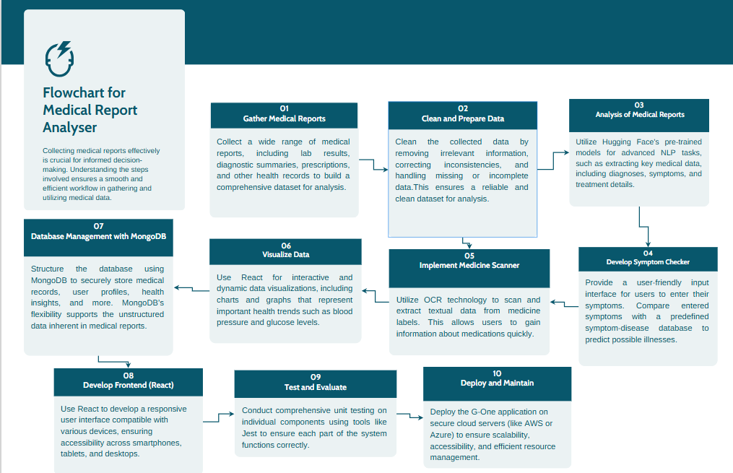
Methodology Flowchart
Notes:
New Courses replaced with New Programmes

Slide 13
Project Timeline
Phase 1
(15th Jan)-
UI/UX Design & Report Analysis Model Training
Phase 2
(1st Feb)-
OCR Integration & Implementing of Report Analysis Model on the website
Phase 3 (15th Feb)-
Medicine Scanner Model Training
Phase 4
(1st Mar)-
Implementing the Medicine Scanner on the website
Phase 5 (15th Mar)-
Dietary plan & Symptom checker Model creation
Phase 6
(1st Apr)-
Implementing the of Dietary plans and Symptom checker model on the website
Phase 7 (14th Apr)-
Testing & Evaluation of all the Models
Phase 8
(26th April)-
Deployment of the web application
Notes:
New Courses replaced with New Programmes

Slide 14
Expected Results & Impact
Anticipated Outcomes of G-One:
Improved Health Literacy: Users will gain a clearer understanding of their medical reports, symptoms, and treatment options, making complex health information more accessible.
Informed Decision-Making: Simplified health insights will enable users to make better, proactive health decisions, reducing confusion and anxiety.
Personalized Health Guidance: Tailored exercise plans and dietary recommendations will support users in managing their health conditions and promoting overall well-being.
Enhanced User Empowerment: By providing tools like symptom checkers and medicine scanners, G-One will reduce dependency on healthcare professionals for basic explanations, fostering self-management.
G-One is designed to effectively address the challenges faced by individuals in interpreting complex medical reports. By simplifying medical data into easy-to-understand language, providing actionable health insights, and incorporating features like symptom checkers and medicine scanners, it bridges the communication gap between patients and medical information. Its personalized recommendations, combined with dynamic data visualization, will empower users to make informed health decisions, reducing confusion and anxiety about their health status.
Notes:
New Courses replaced with New Programmes

Slide 15
G-One will deliver a working prototype as part of the project. This will be a web-based application where users can upload medical reports, scan medications, check symptoms, and receive personalized health insights. The prototype will demonstrate core functionalities, including report analysis, OCR integration, medicine scanning, dietary planning, and data visualization. It will showcase real-time interactions, secure data handling, and responsive design, offering a practical simulation of the final product's capabilities.
Contributions of G-One to the Medical field
Improves Health Literacy: Simplifies complex medical reports and health data for better understanding by non-medical users.
Empowers Informed Decision-Making: Provides clear insights to help users make proactive health decisions.
Supports Personalized Health Management: Offers tailored exercise and dietary plans for managing individual health conditions.
Optimizes Healthcare Resources: Reduces dependency on healthcare professionals for basic health information, improving efficiency.
Potential Benefits:
For Industries: G-One can collaborate with medical laboratories to create a referral system, where users, after checking symptoms, are directed to authorized labs for tests, increasing traffic and potential revenue for these labs.
Notes:
New Courses replaced with New Programmes

Slide 16
For Researchers: The data collected through symptom checking and user reports can serve as valuable insights for medical research, helping in understanding health trends and patterns.
For Users: G-One offers free access to symptom checking, helping individuals identify potential health risks and take timely action, improving health outcomes without the burden of extra costs.
Future Scope and Extensions:
Collaboration with Laboratories: By collaborating with laboratories, G-One will direct users to authorized labs for further testing, creating a streamlined process for health assessments. This partnership will offer laboratories a wider reach, encouraging more referrals.
Supporting Labs and Expanding Access: As laboratories advertise their services on the G-One platform, they will pay for these placements, offering G-One a sustainable revenue stream. Additionally, we could implement a referral model, where a small fee is earned for each user who completes testing through the platform’s lab recommendations, benefiting both users and labs.
Expansion of Services: G-One plans to expand its symptom checker to cover more diseases .This improvement will enhance the comprehensiveness of the service, providing users with broader health insights and a more robust tool for managing their well-being.
Notes:
New Courses replaced with New Programmes

Slide 17
References
Choi, J. Y., & Park, J. (2019). A survey of medical data mining approaches for e-health applications. Journal of Healthcare Engineering, 2019, Article 1234786. https://doi.org/10.1155/2019/1234786
Shetty, V., & Raghavendra, P. (2020). Artificial intelligence in healthcare: Challenges and opportunities. Journal of Healthcare Informatics Research, 4(2), 1–15. https://doi.org/10.1007/s41666-020-00042-1
Jain, S., & Patel, N. (2021). Medical report summarization using natural language processing. Healthcare Technology Letters, 8(3), 1–8. https://doi.org/10.1049/htl.2020.0164
Usman, M., & Khan, I. (2020). A survey on health data mining: A data science approach for healthcare systems. Journal of Healthcare Engineering, 2020, Article 9705741. https://doi.org/10.1155/2020/9705741
Kumar, M., & Verma, A. (2022). Health insights and predictive analytics in medical systems: A review. Journal of Medical Systems, 46(12), Article 210. https://doi.org/10.1007/s10916-022-01913-9
Notes:
New Courses replaced with New Programmes

Slide 18
THANK YOU

